Slide 1
Jill Rapson
Submission to Commissioners re: Proposed Plan Change 1 : Increased housing supply and choice
Heritage preservation is a one-time opportunity.
Future plan changes need room to operate.
Sunlight and privacy require protection.
Affected neighbours should be compensated.
People need gardens and trees which need space.
Climate change is happening.
Context, scale, equity

Slide 2
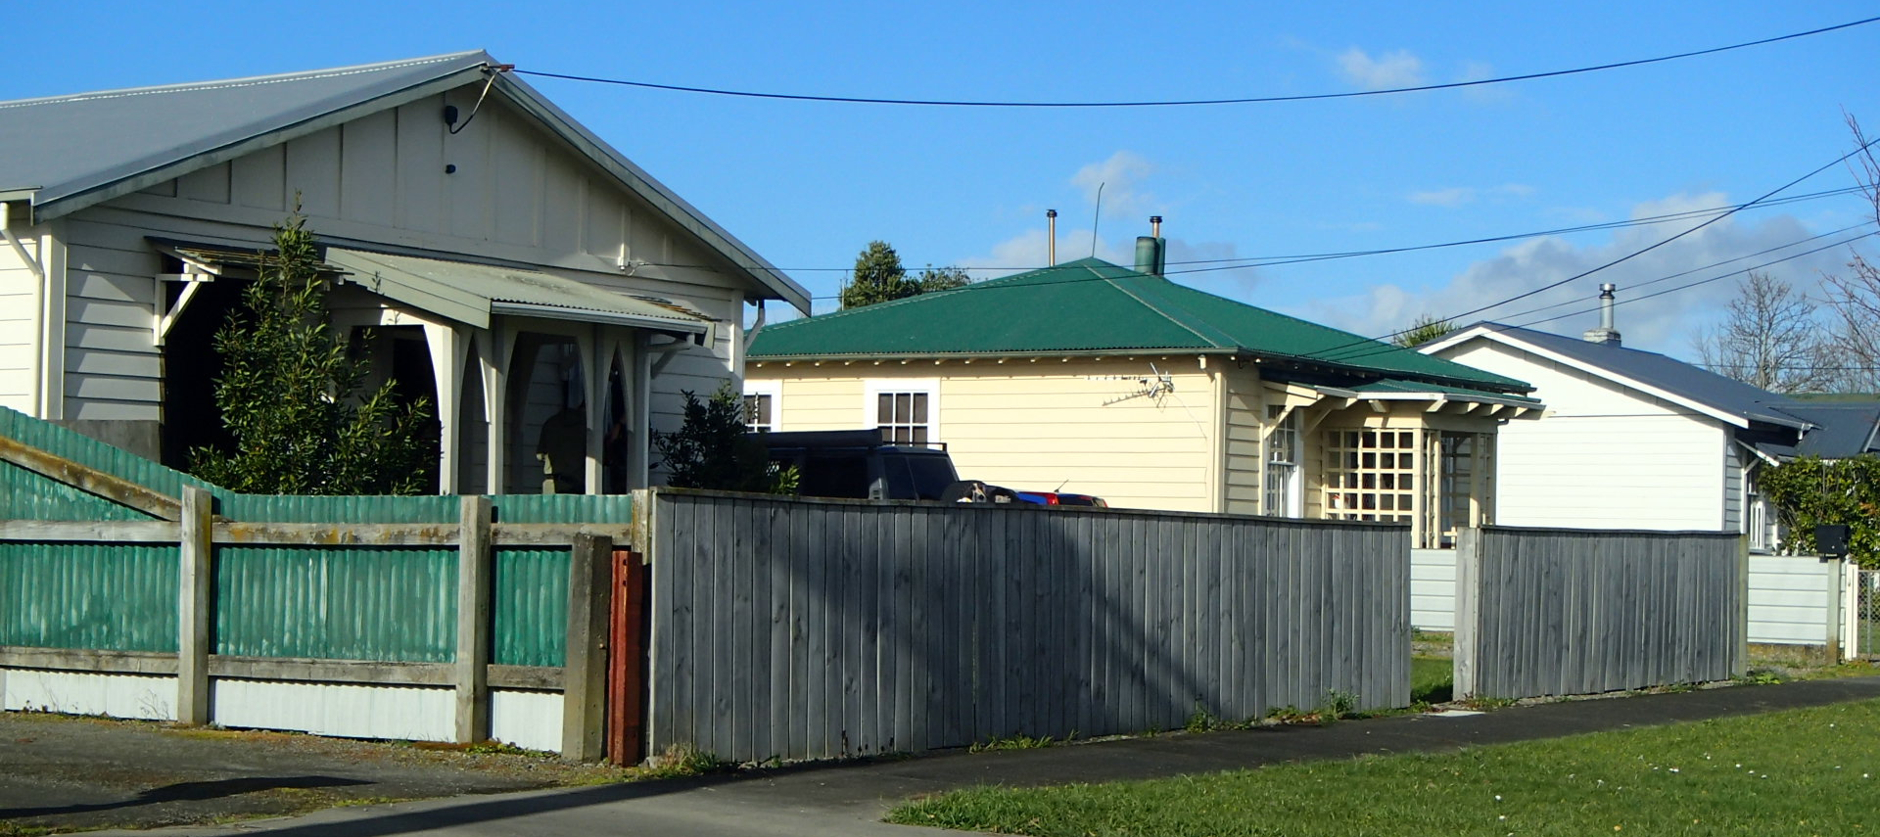
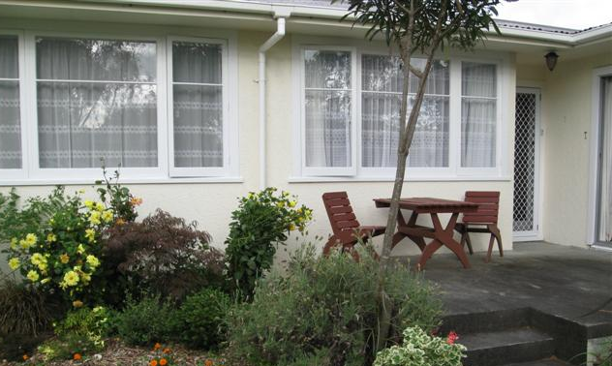
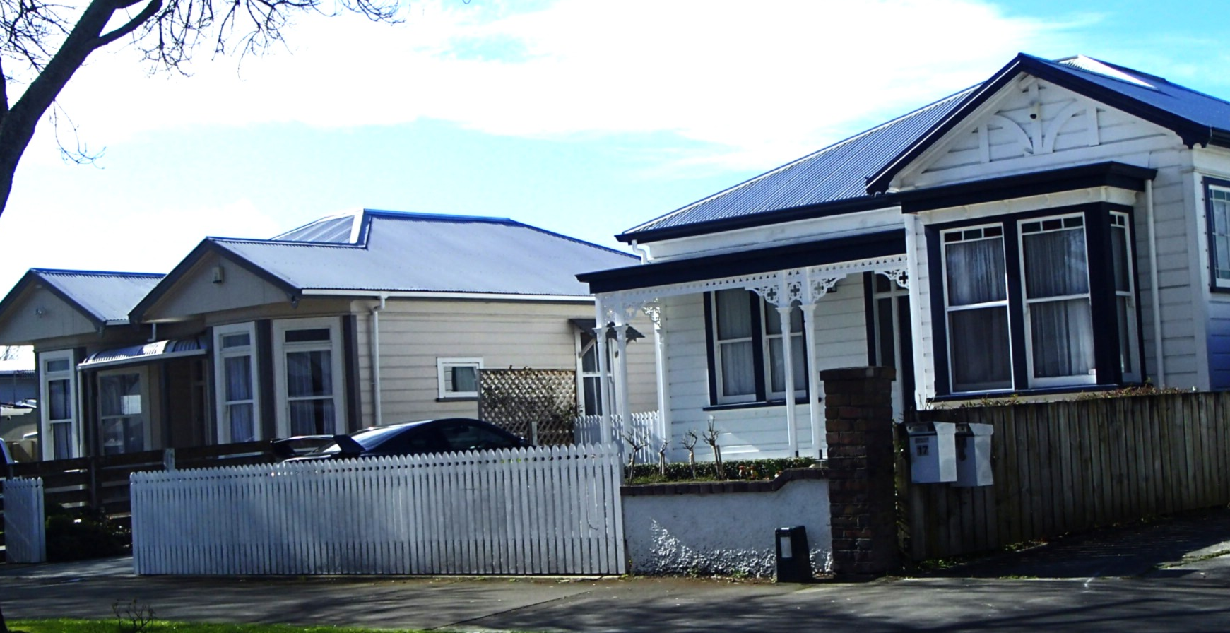
1) Blanket permissions to “develop” PN will result in missed opportunities to protect (examples of) heritage buildings and architectural styles.
c.f. Savage Crescent – is enough preserved?
e.g. railway housing,
turn-of-the-century villas,
1960’s group housing,
1970’s minimalism,
even modern styles.
These decisions need making soon.

Slide 3
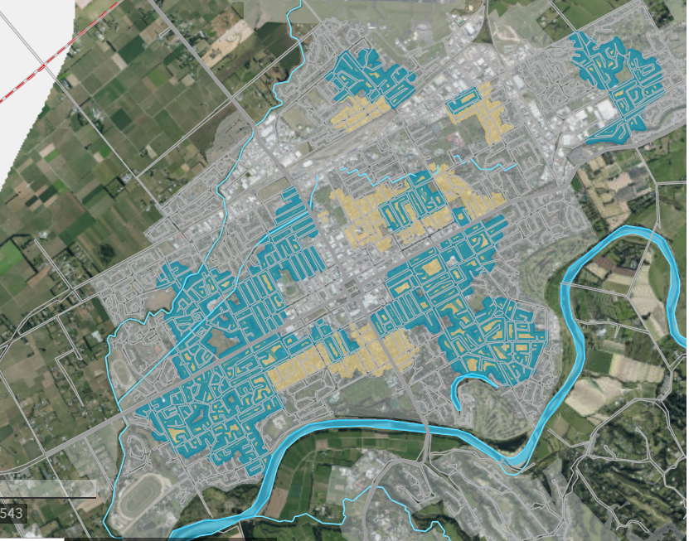
2) Use a random quarter for the Proposal
Leaves the rest of city for later changes to planning.
Concentrates issues which will arise (e.g. H₂O,
sewage, stormwater).
Localises necessary infra-structural modifications
Avoids pepper-potting of styles.
Limits rate-payer irritation.

Slide 4
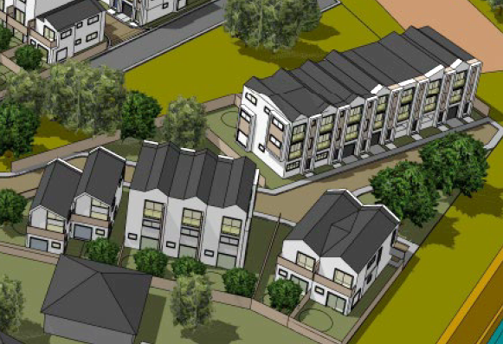
3) Sunlight and privacy - Context of Proposals matters
Interested because of known impacts (in other areas)

Slide 5
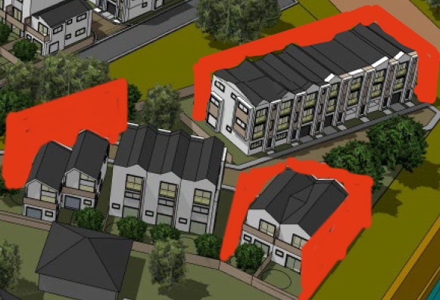
Planning might differ if "sites" were thought of as being INSIDE (red) boxes.

Slide 6



Imagine a home INSIDE a box, so the home had only tiny back and side gardens.
Almost a terrace house,
but with minimal outdoor space.

Slide 7
If the red boxes are not part of the thinking, then advantage is being taken of open spaces (blue) being owned, occupied or manged by others.
Is that equitable?

Slide 8
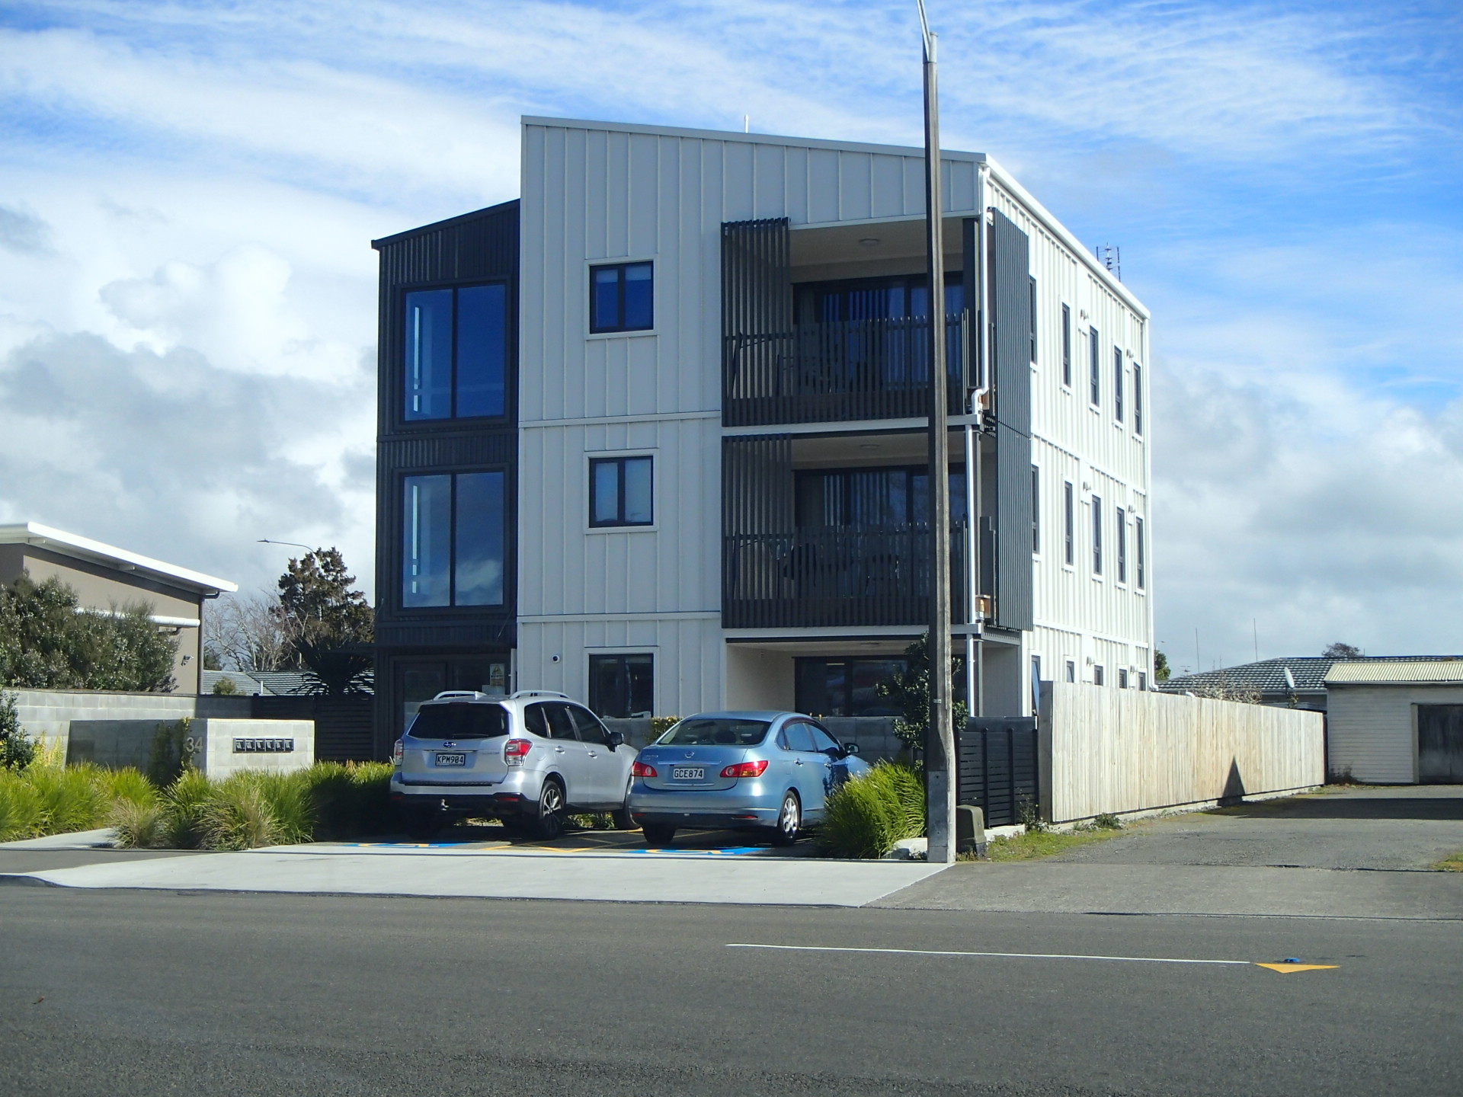
Three-floor dwelling complexes

Slide 9
Is a row of these tolerable?
2m?
How big is this gap?
How big is this gap?
More tolerable?
Different planning zone?
How big is this gap?
How big is this gap?
First floor
Ground floor

Slide 10
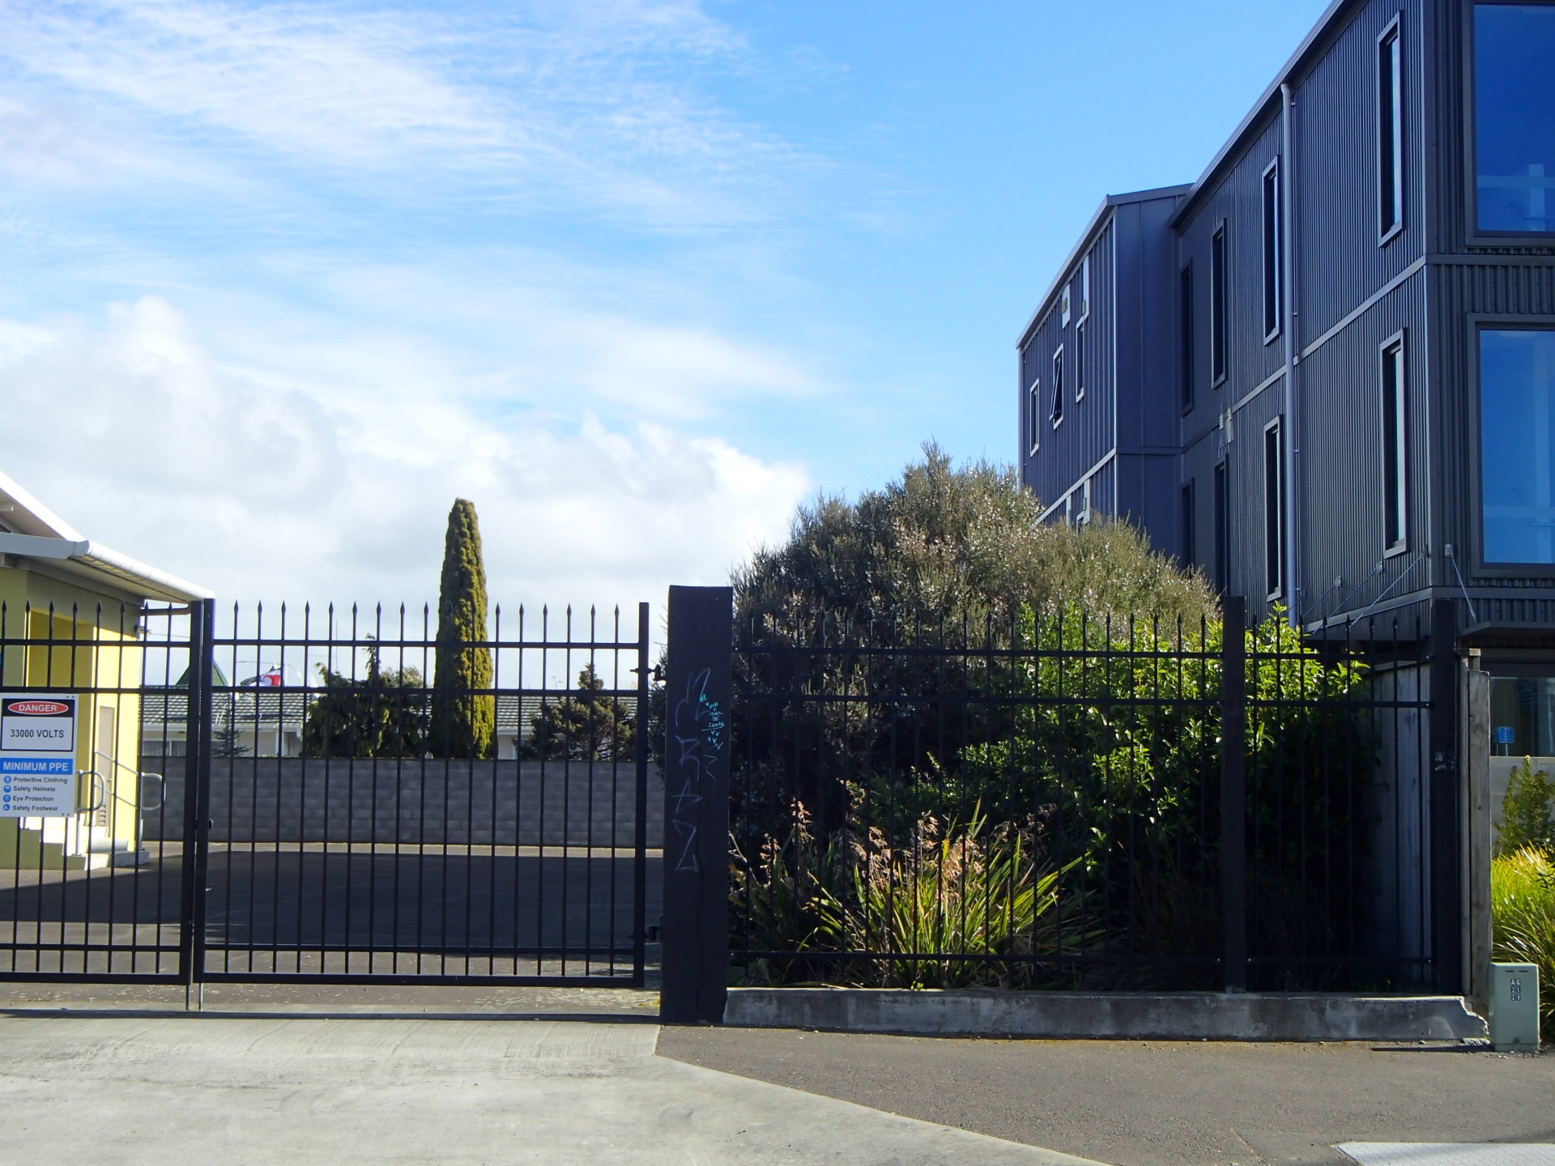
Shadow
(2.15 pm; Aug 28)
Ground floor has no sun for rest of day
How big is this gap?
How big is this gap?
First floor
Ground floor

Slide 11
New building conditions affect neighbours, especially their sunshine and privacy
This represents a loss of value to the red house.
Shadow

Slide 12
4) Equitable compensation
Historic peculiarities have to be lived with.
Future owners buy as seen (so are not affected).
For current neighbours loss of value / values through a new adjacent building is inequitable.
Compensation should be part of costs of "development".
Options could be settlement or even buy-out.
Settlement with neighbour should reflect actual loss of market and amenity values.
Best standardised at city-level (?).

Slide 13
Recession planes delimit volumes, which could be used as quantifiers
Available volume (occupiable) = average cross-sectional area between current recession plane and planned recession plane on the same vertical lines.
Depreciated volume (occupied) = area of difference between current recession plane and planned building
Scaled by length of planned building.
How to quantify loss of amenity values?

Slide 14
5) Greenery
Diagrams have (wispy) trees
create privacy (mostly desirable)
create shade (may not be wanted)
block views, outlooks etc
trees don't stay wispy
require maintenance re leaf litter etc.
More need for public spaces (instead of losing these).
Are street trees enough? Are they satisfactory?

Slide 15
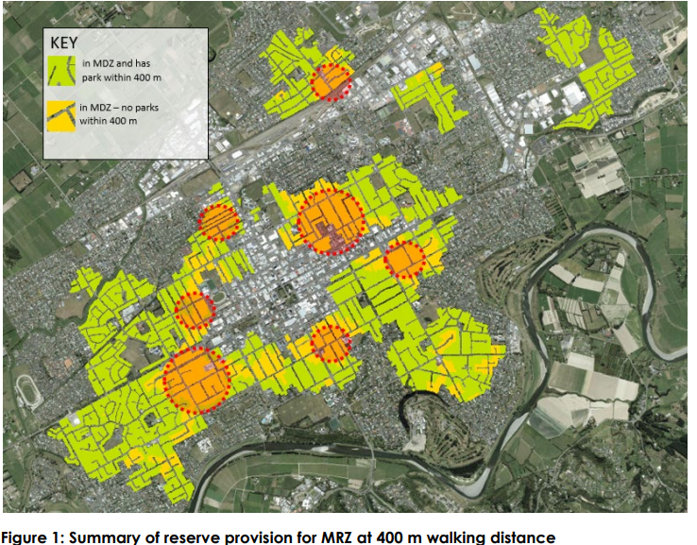
Where is the greenery coming from?

Slide 16
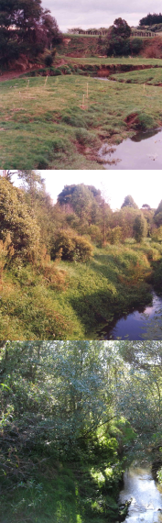
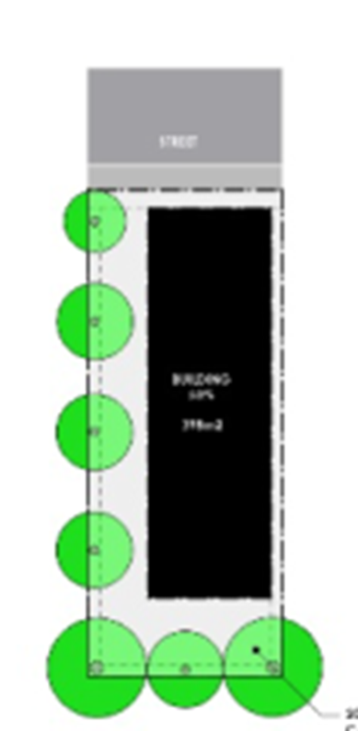
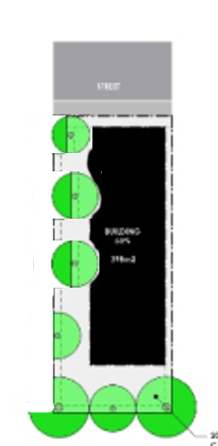
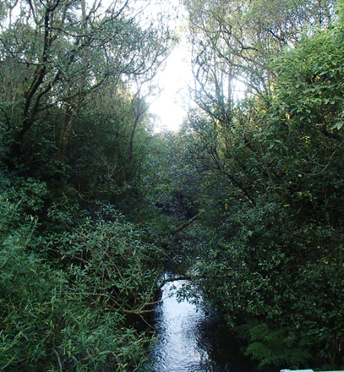
Does the desirability of green and/or open spaces increase as housing density increases?
I generally agree with the Landscape report!
1995
Most plant species do not grow in shade or concrete-rich areas.
Tree seedlings grow.
Overhanging the neighbour ?
Which floor has its windows foliated?
Who deals with dehisced leaves, flowers or fruit/cones etc?
Who decides when to cut trees out?
Is treelessness a breach of council regulations?
Street (?)
2003
2010
2023

Slide 17
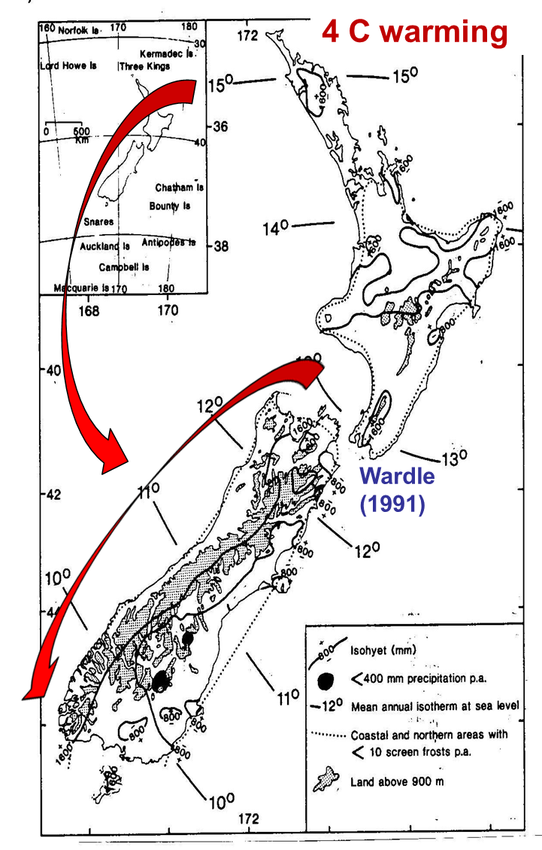
6) Climate change
Issues arising:
Storm water
Flood levels
Ground-water levels
Cooler c.f. warmer houses?
Insurance issues (esp. for blocks, semi-detached etc.)
Rates?
Tree dieback

Slide 18
Q's ?

