Slide 1
Parking Framework Workshop
30 August 2023

Slide 2
Workshop Outline
Follow up from Community Committee 9 August
Why do we need a parking framework
Supporting Projects
What's been done to date
Engagement or Consultation
Parking workshop opportunity

Slide 3
Community Committee 9 August Follow up
Ministry of Social Development SuperGold card/disability allowance
Current mobility permit data*
Timing of SGC extended hours implementation
Council’s financial impact
Super Gold no disability allowance | SuperGold with disability allowance | Total Disability allowance
11,853 | 2,484 | 4,740
Total Mobility Permit | Under 59 | Over 60
3165 | 670 | 2495

Slide 4
Why do we need a parking framework?
Parking is inextricably linked to how Palmerston North’s transport system operates, and there are many longstanding and growing issues that require attention.
Fewer people are walking, cycling and catching the bus
Our road safety record is getting worse
Transport is the greatest contributor to carbon emission in the city
Our roads are deteriorating
Car ownership is increasing
Car dependency is impacting our health
Demand for parking is likely to increase while supply likely decrease

Slide 5
Where the parking Framework fits
Keeping Cities Moving
Government Policy Statement on Land Transport
National Documents
Parking Management Plans
(location specific operations)
National Policy Statement on Urban Development
Parking Framework
Long Term Plan
Traffic & Parking Bylaw
(legal enforcement)
Transport Plan
PNCC Documents
Economic Development Plan

Slide 6
Connected Projects
Speed Management Plans
Transport Choices
Urban cycle network
City Centre Transformation- Streets for People
Horizons new bus network
Main St Transit Hub

Slide 7
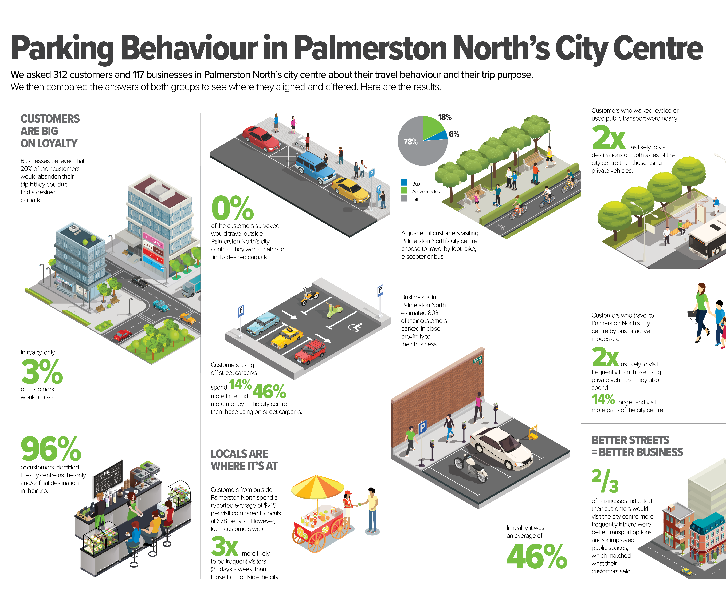
Work to Date
Parking Survey (March 2022)
Initial stakeholder engagement (September 2022)
Working draft development

Slide 8
Draft Framework
Challenges
Managing Supply and Demand
No one size fits all
Current practice does not support equitable access
Ongoing safety concerns
Lack of integration with the wider transport system
Managing time and price
Technology and emerging demands

Slide 9
Draft framework
Principles
Prioritise public space to deliver the highest value to our residents
Ensure parking supply is appropriate to the adjacent use
Prioritise users with the greatest need for parking
Equitable pay for the cost of parking provision
Ensure parking management actions are considered as part of an integrated transport system
Ensure parking supports a quality urban form
Make transparent and evidence-based decisions
Provide a high-quality user experience for all parking users

Slide 10
Engaging with our community
Option 1- direct engagement | Option 2- Consult | Option 3 – Consult as a part of the LTP
Workshop with elected members | Workshop with elected members | Same As option 2
1-1 Engagement with key stakeholders | 1-1 Engagement with key stakeholders | LTP is the consultation vehicle
Report parking framework back to Council for approval | Draft Policy Framework to Committee
This would be a faster process but wouldn’t engage the wider community. | Formal Consultation including hearings and then a final decision
Recommendation- Option 3- Consult as a part of the LTP

Slide 11
Parking Workshop opportunity
Provided by Waka Kotahi, so no cost to council.
Independent experts talking about parking drawing on experience from other cities.
Could host a workshop as a part of the engagement/consultation process.

