Slide 1
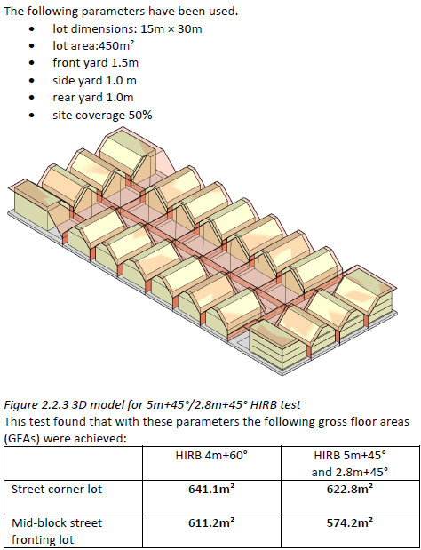
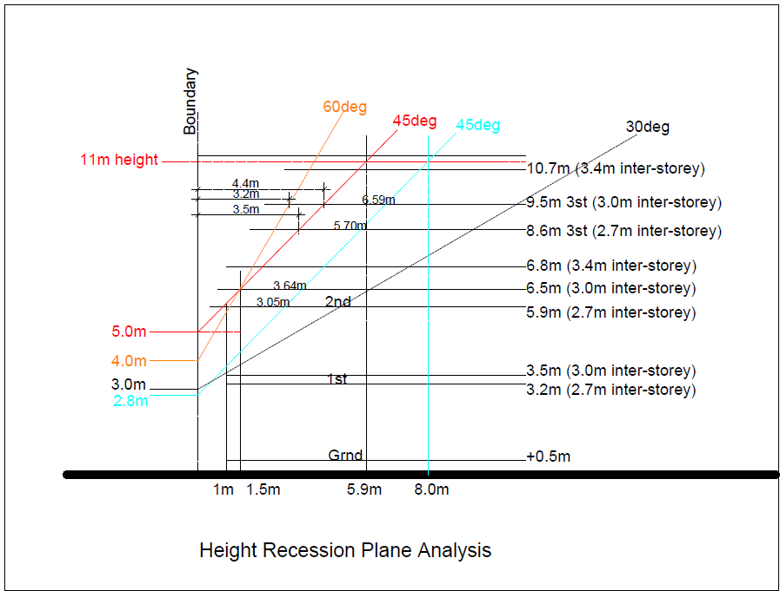
HIRB and Yield Analysis
2.8% & 6.1% less GFA
PCI vs MDRS

Slide 2
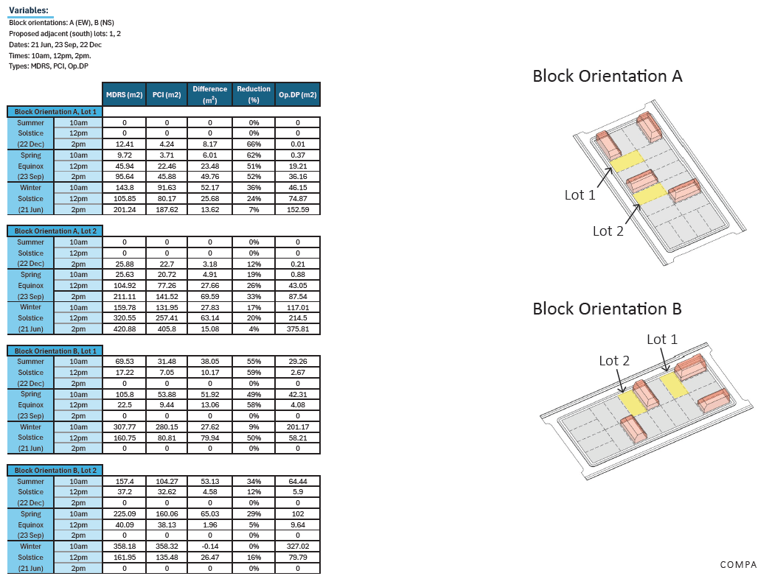
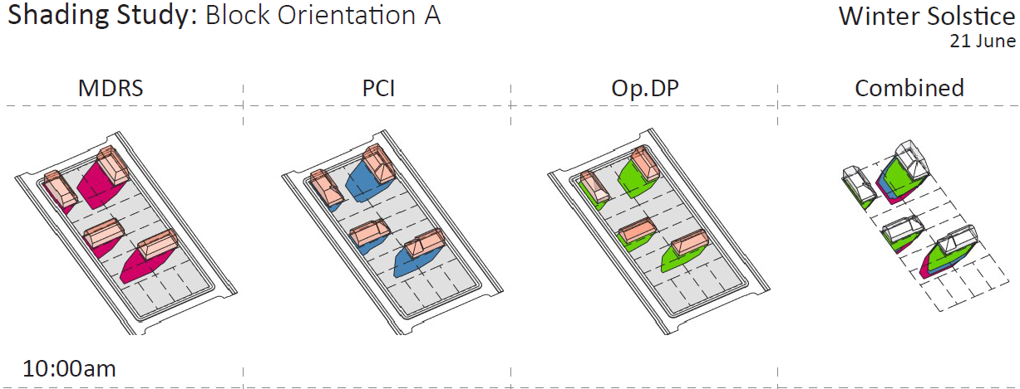
Sunlight Shading
Mid-winter shading reduction:
7% - 24% - 36% - 50%

Slide 3
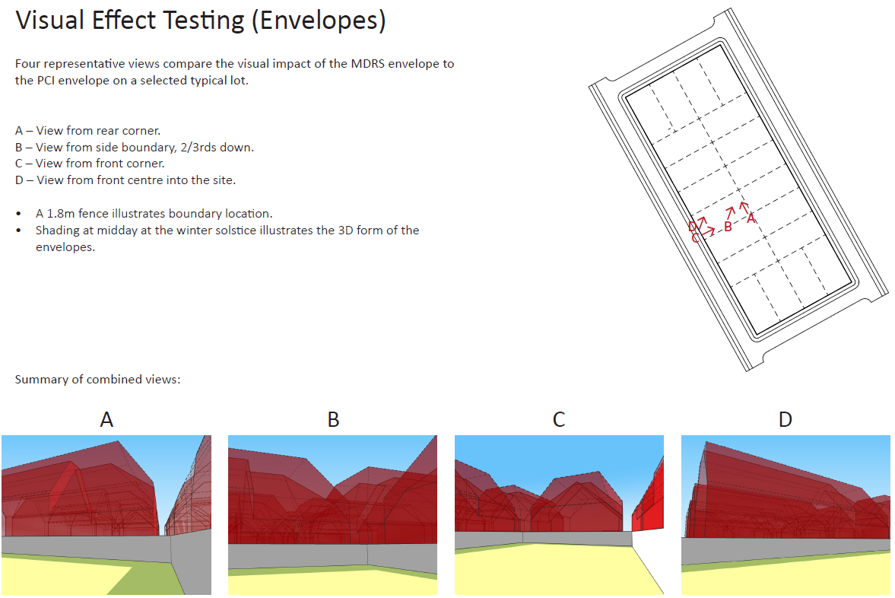
Visual Effect (Envelopes)
13% - 26% reduction in visual dominance
PCI vs MDRS

Slide 4
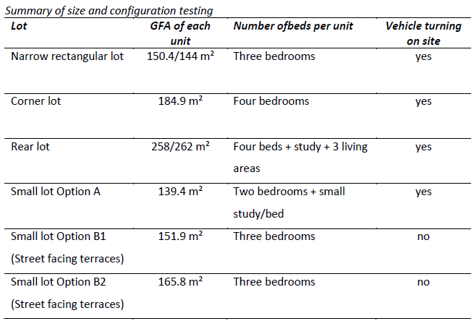
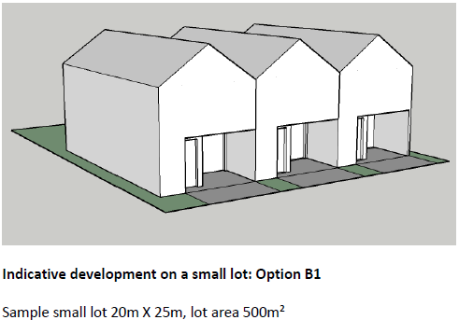
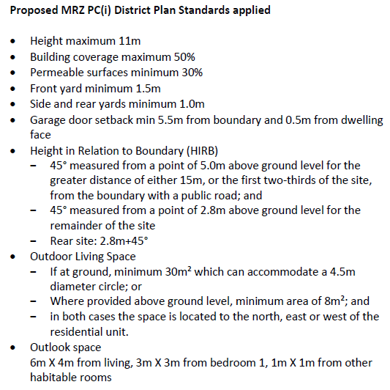
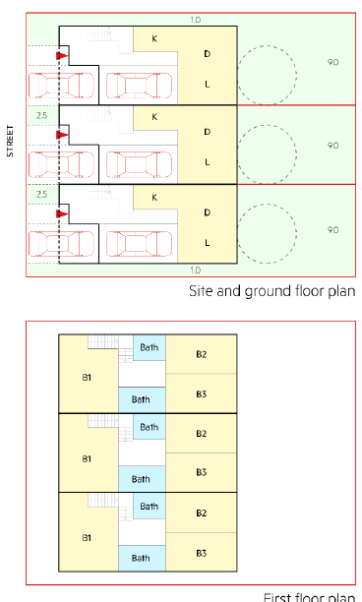
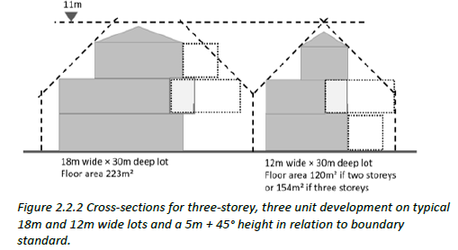
Lot Testing

Slide 5
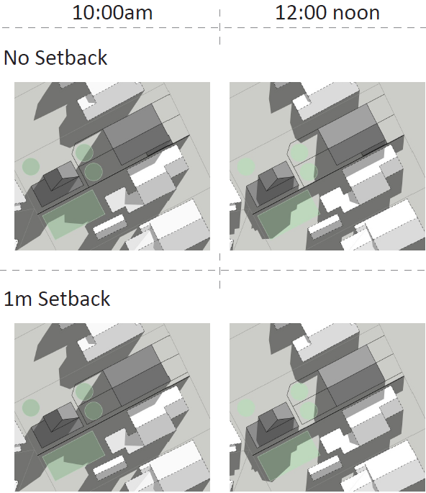
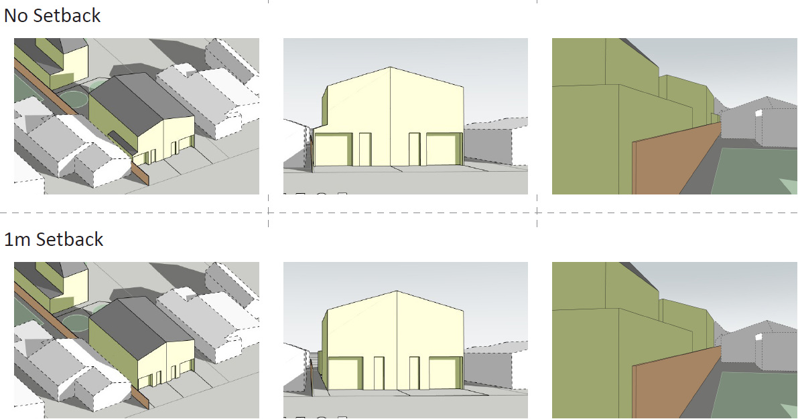
Garage Setback - Zero Lot Line

Slide 6
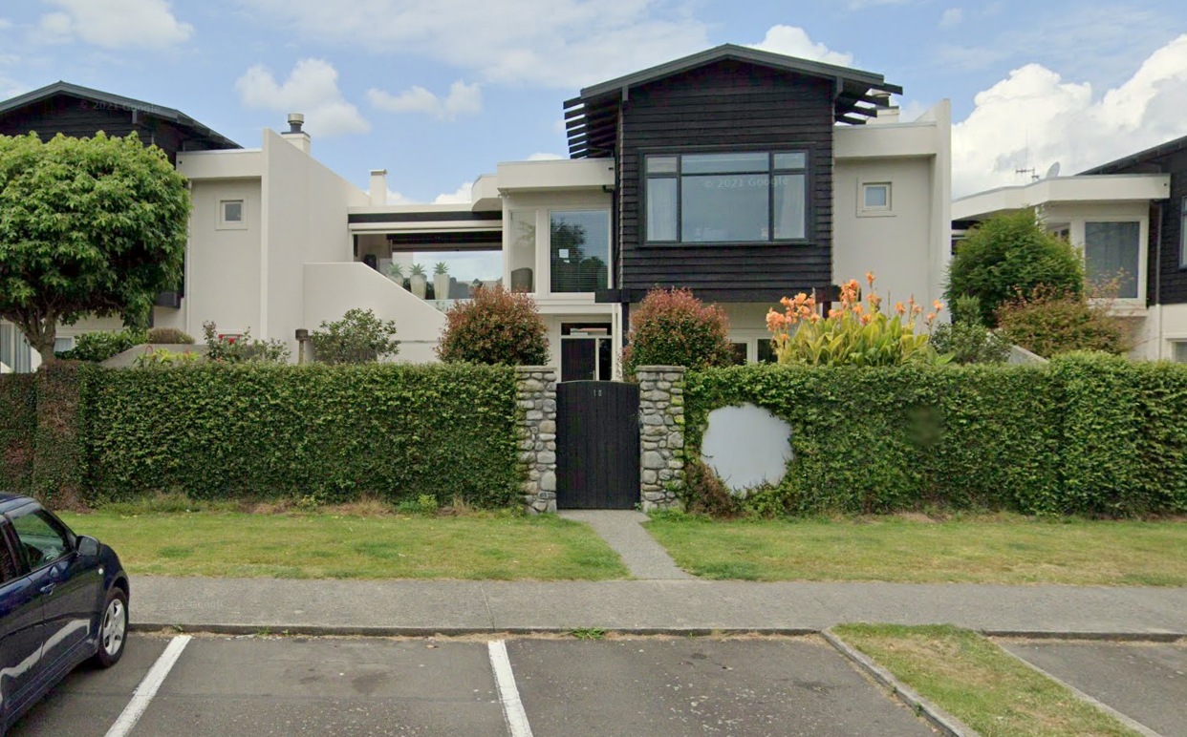
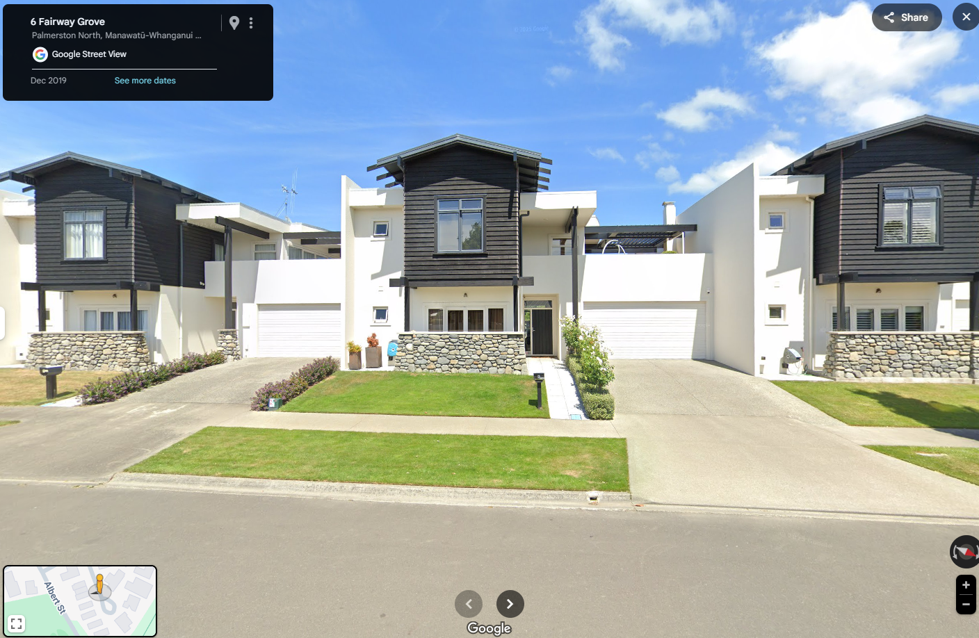
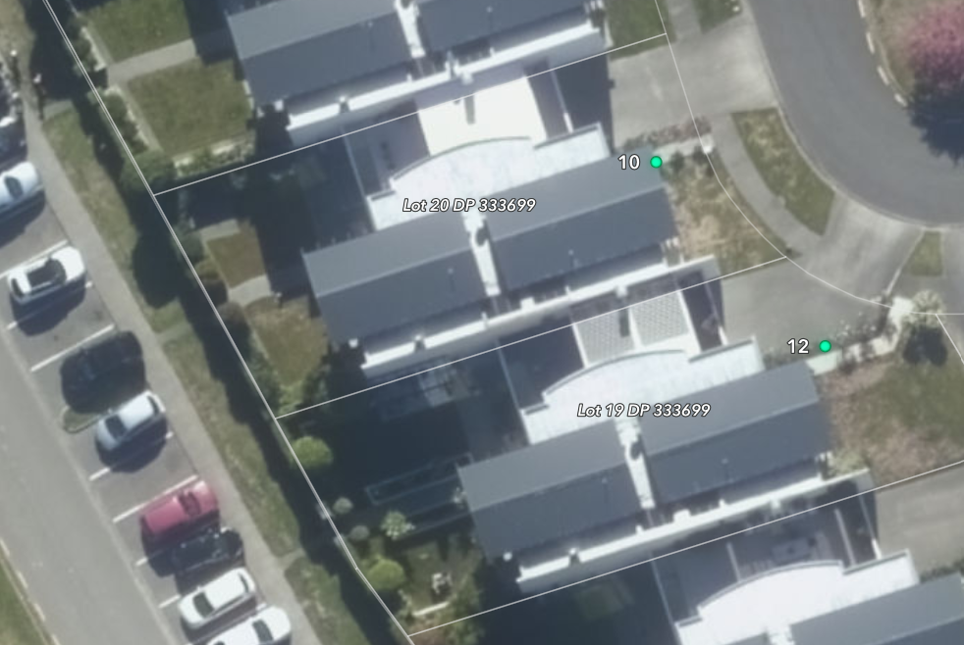
Setback - Zero Lot Line – Albert Street and Fairway Grove

Slide 7
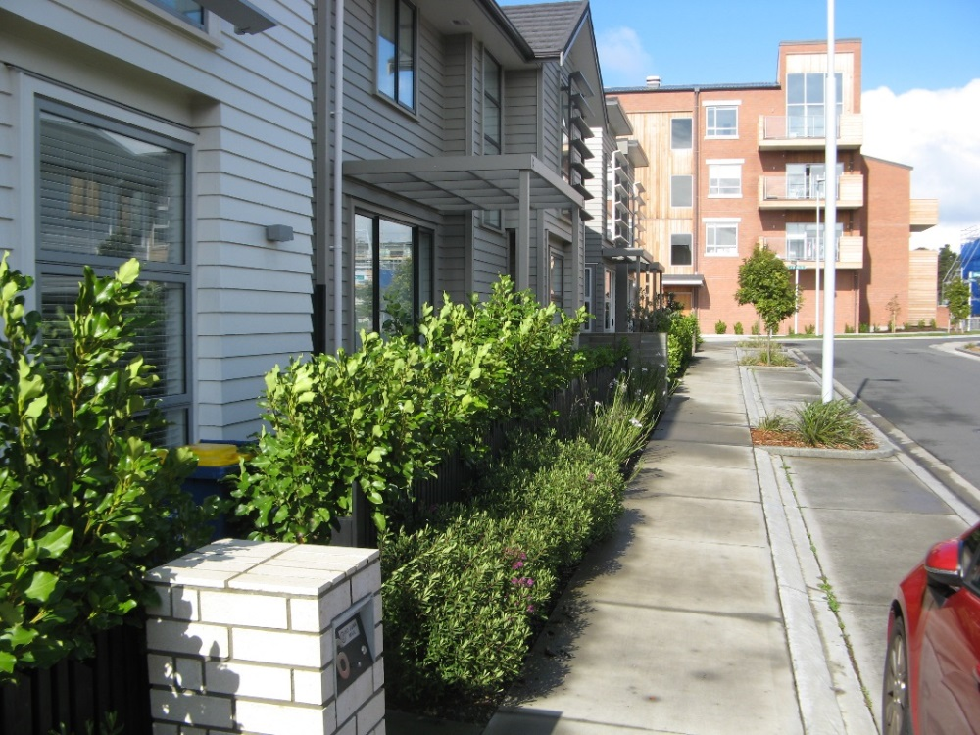
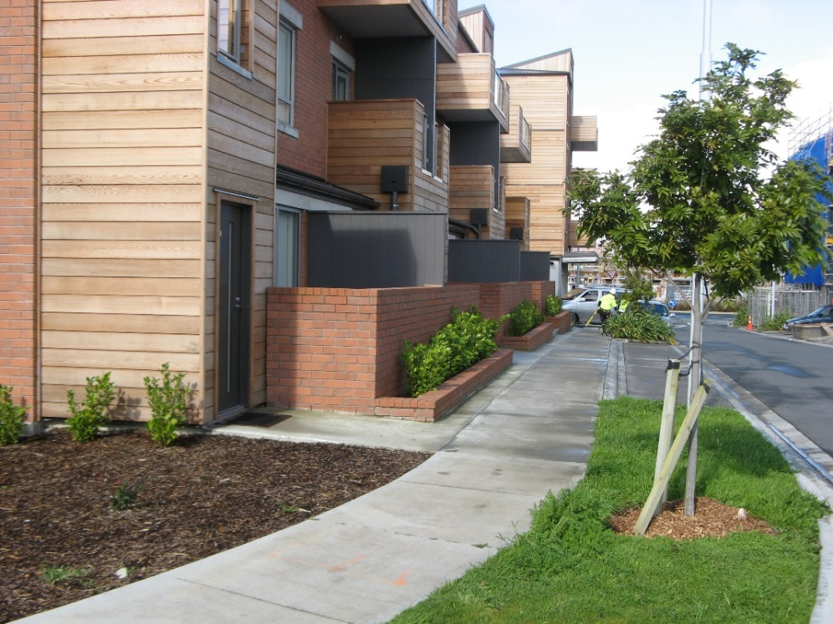
Setbacks - Development example
Shallow setbacks and frontage treatments at Hobsonville Point
Example of a shallow, planted yard at the frontage of two storey terraces, with frontage planting giving considerable privacy in views along the footpath.
The image at right demonstrates the positive effect of a shallow frontage setback and provision for open space and entrances along the edge of the three storey component of an apartment development. This shallow frontage setback with an approximately 1.8 metre deep terrace provides for sufficient separation from the street and also allows for small ground floor open spaces.

Slide 8
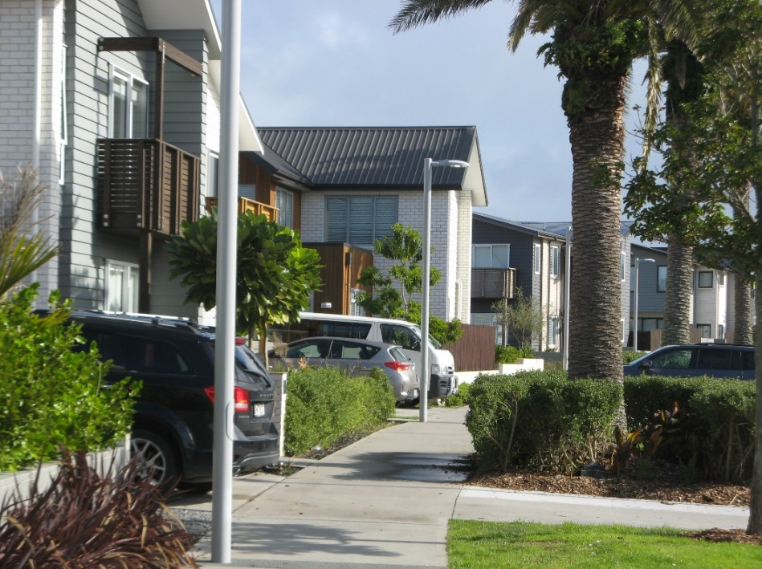
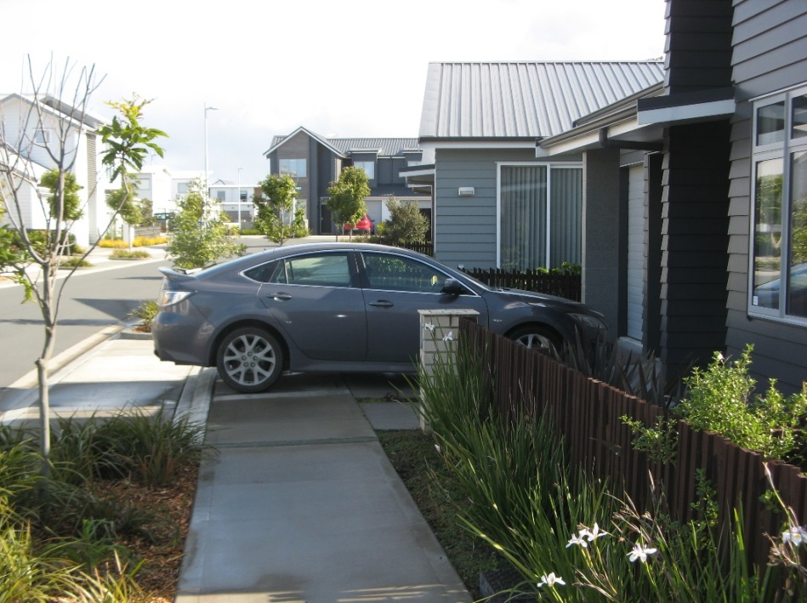
Garage setback
Garage setbacks from the street at Hobsonville Point
The garages at right are set back 5.5m to allow a clear footpath and, in combination with low frontage landscaping, minimise the appearance of cars parked in front of the garage door
Illegal parking (left) with shallow setback, meaning that a car parked in front of the garage door blocks the footpath.

Slide 9
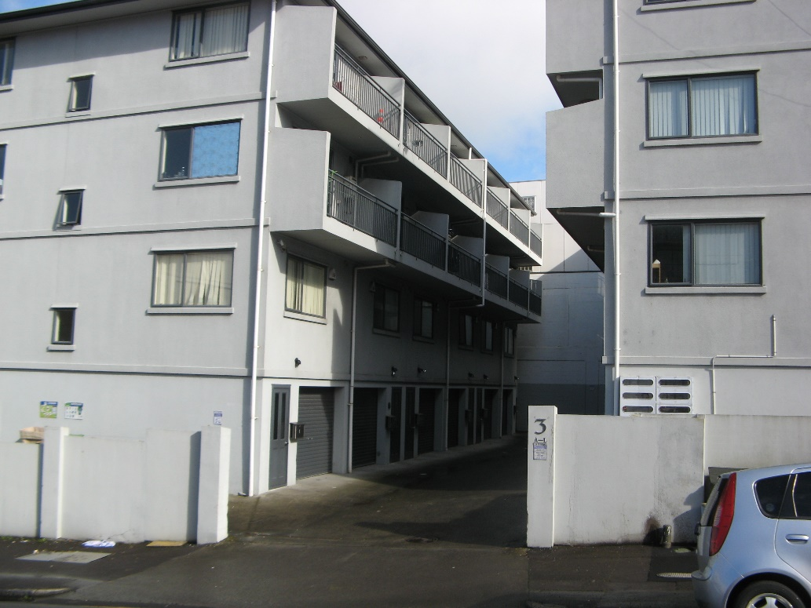
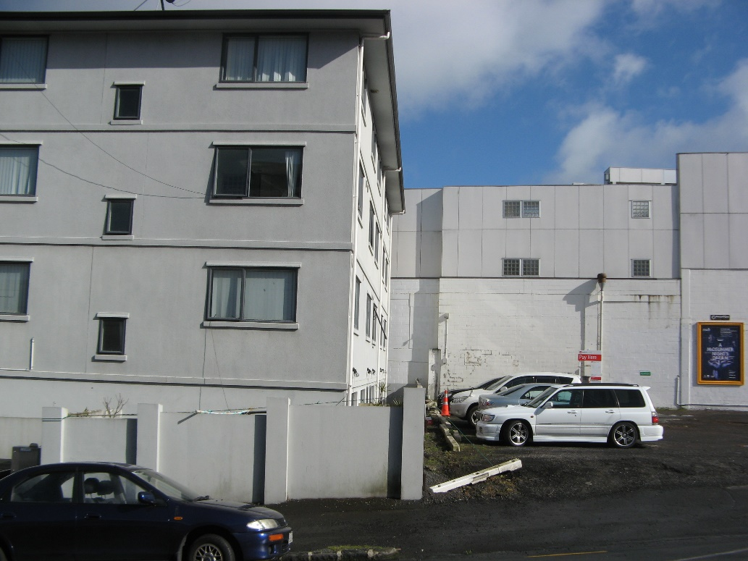
Space between buildings - Development example
Auckland - 3 Exmouth Street
These facades are in the order of 7m apart at ground, and with balconies cantilevering an estimated 1.2 metres, around 4.6 metres apart at the upper levels.
The image at right shows limited setback from the side boundary, which might allow this development to be built out, resulting in extremely poor amenity outcomes. The proposed outlook space controls would not permit such a solution.

Slide 10
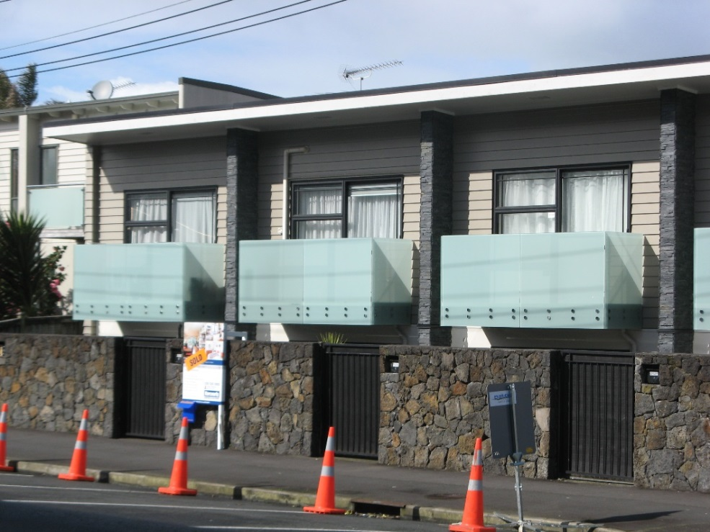
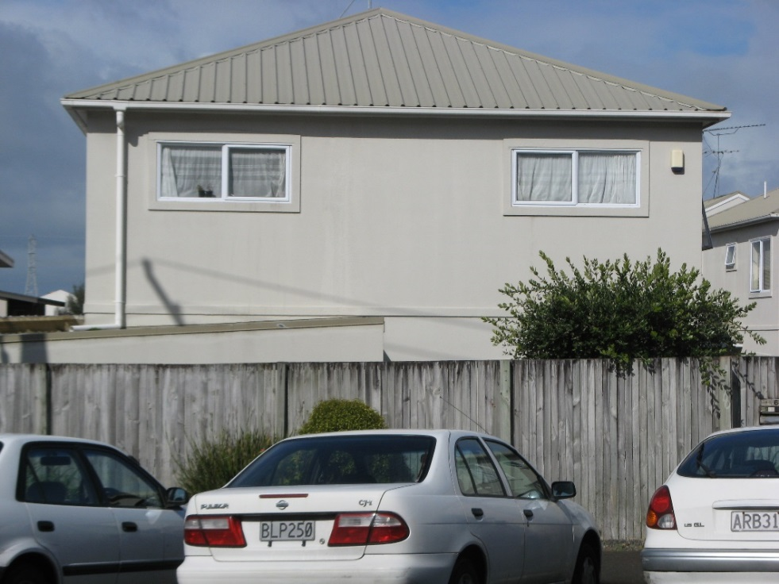
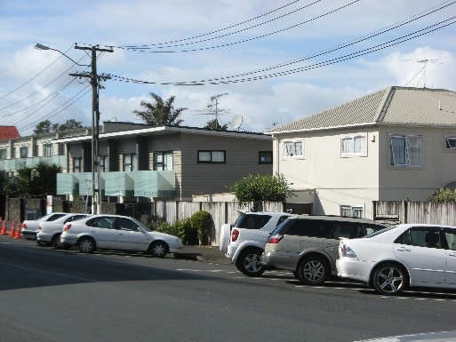
Frontage and glazing
Church Street Onehunga
The development at left positively fronts the street with a sufficiently low fence, extensive glazing, visual richness and variation of materials in the design.
This contrasts with the neighbouring development at right which presents a poor frontage characterised by blank walls and high front fence to the street.

Slide 11
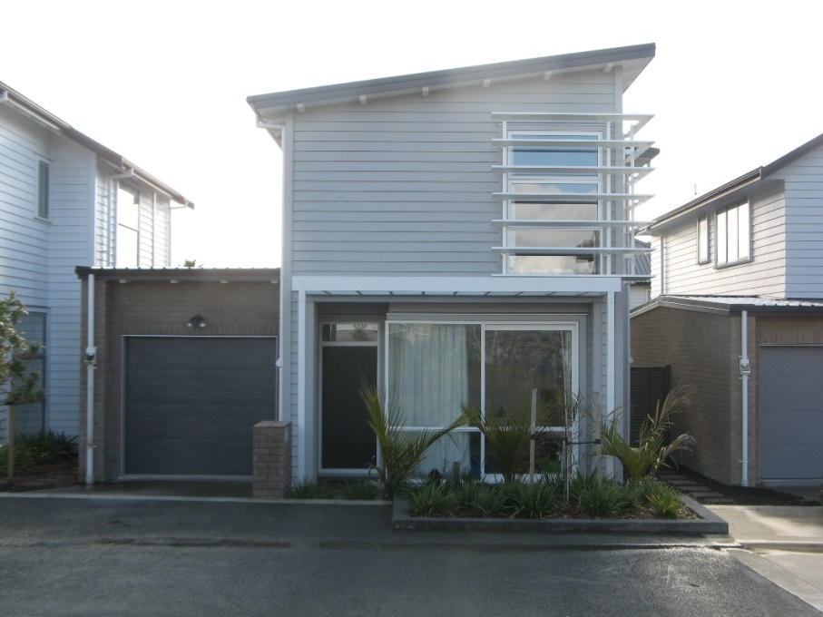
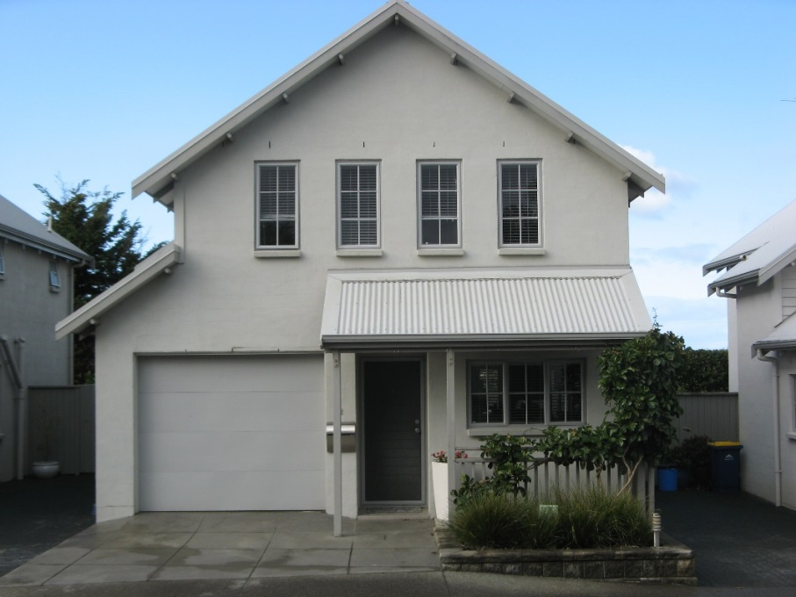
Garage Door Widths Development example
Garages facing the street at Hobsonville Point (left), and facing an internal accessway at Albany Village (right)
In the example at left, the garage door occupies around 28% of the frontage width, and the garage as a whole around 36% of the frontage.
The garage door at right occupies around 35% of the frontage width, and the garage as a whole just over 43% of the frontage.
These demonstrate that a garage comprising a relatively low portion of the frontage width and which is set back in a composition that maintains the dwelling and entrance as prominent at the street edge will be successful. In views along the street the garage doors here will be visually recessive.

Slide 12
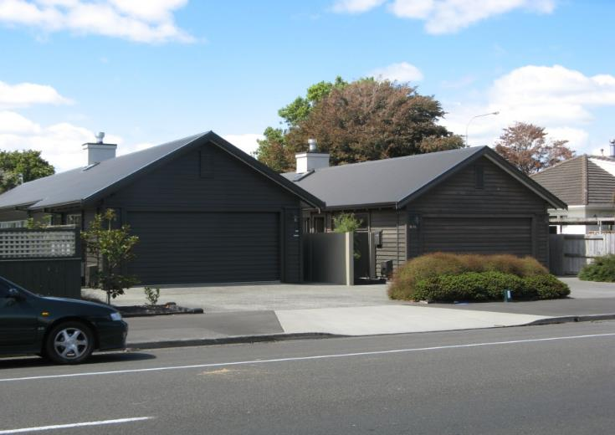
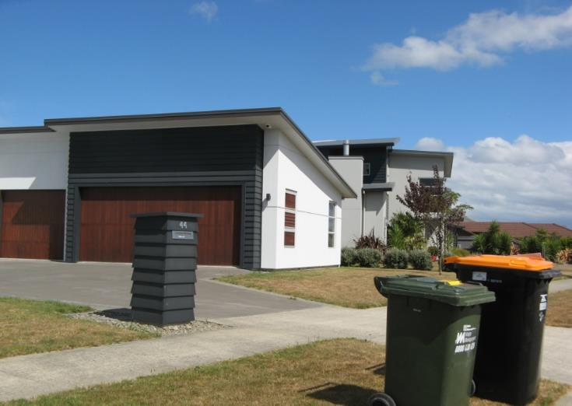
Garage dominance
Poor outcome with garages forming the entire frontage of a residential development.
Weak entry / legibility.
Out of keeping with properties around, and planting will not be able to mitigate the effect of closure and monotony, even when it matures.
Side-entry garage with some façade fenestration. Setback can allow planting to occur.

Slide 13

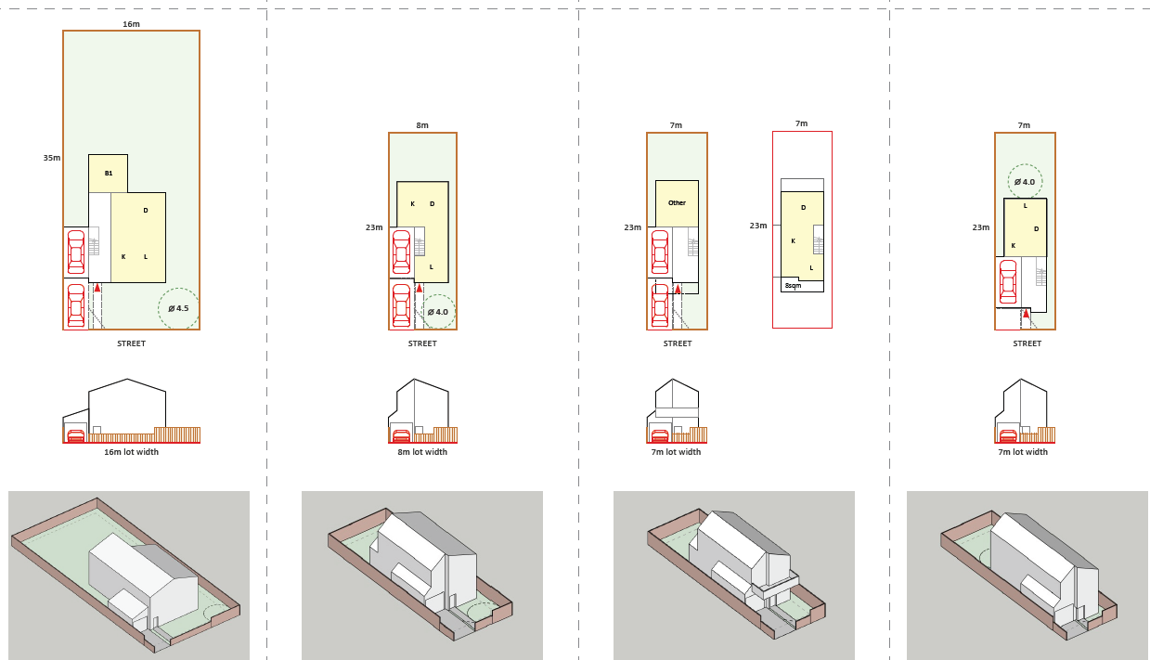
Fencing Provisions

Slide 14
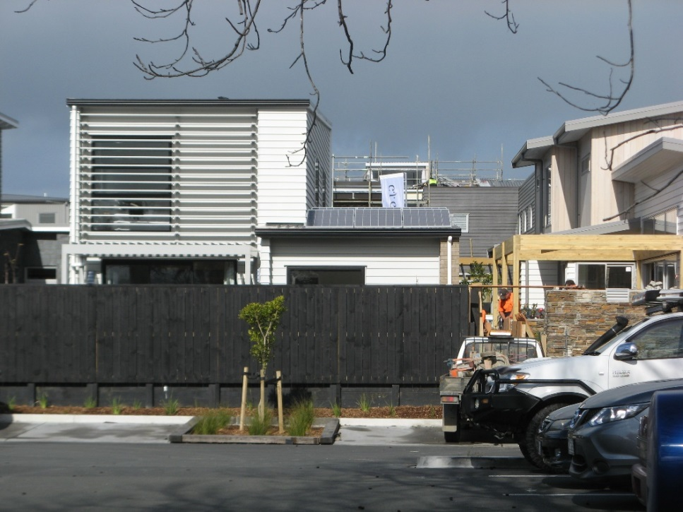
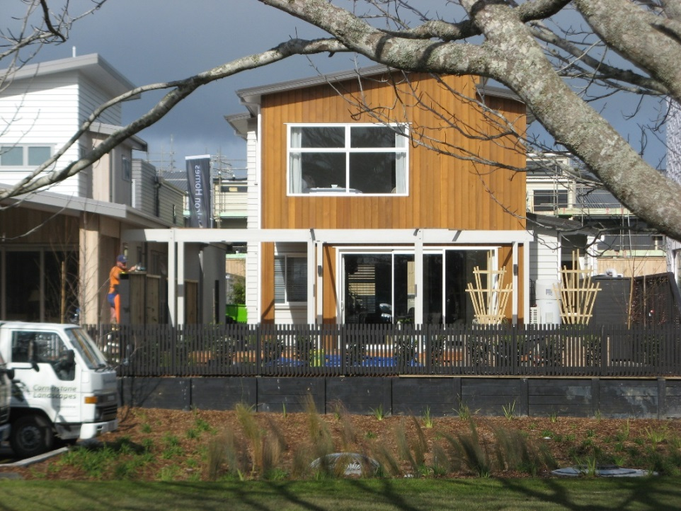
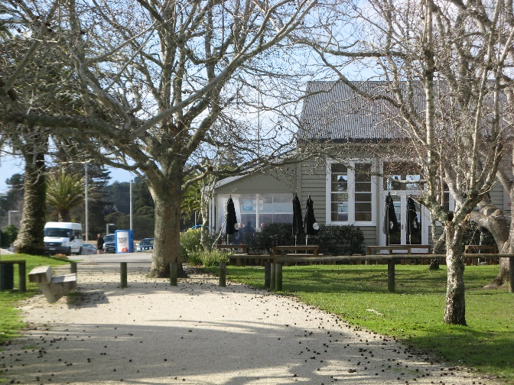
Front fences
Contrasting front fences on near neighbours at Hobsonville Point
Both of these dwellings look out onto the open space by the Catalina Café. Both open areas are elevated above the park level.
While the example at left looks primarily over the café carpark, the fence cuts it completely off from this and the adjacent park, when due to change of level a lower fence would have provided privacy as well as a view out over the park. The example at right and other frontages further along achieve a successful balance of privacy and connection.

Slide 15

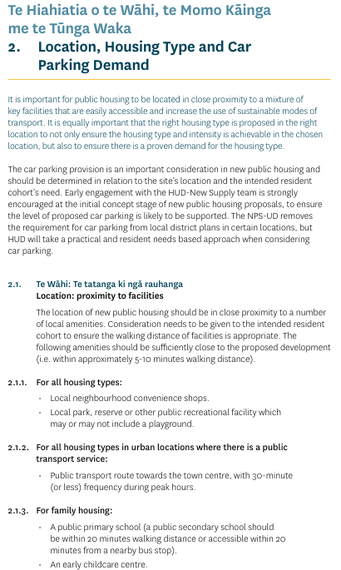
“Important for public housing to be located in close proximity to a mixture of key facilities…”
“Amenities should be sufficiently close … 5-10mins”
Neighbourhood shops
Local park / reserve
Public Transport
Primary school
Childcare
Consideration also:
Medical centres
Community support
Public recreation
MHUD – Guidance for CHPs
“Requirements for an application…”

Slide 16

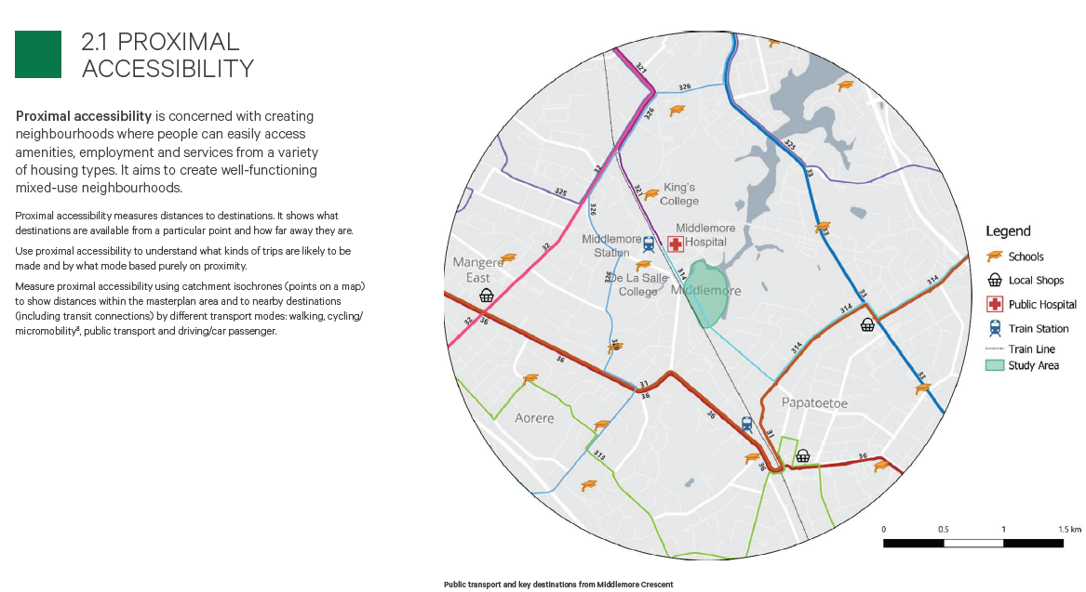
Walkable Catchments and Density

Slide 17
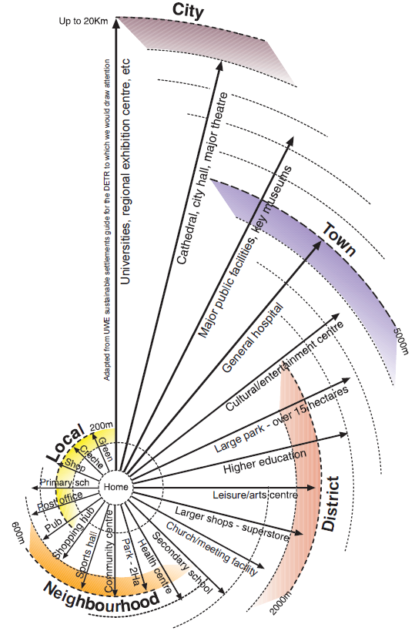
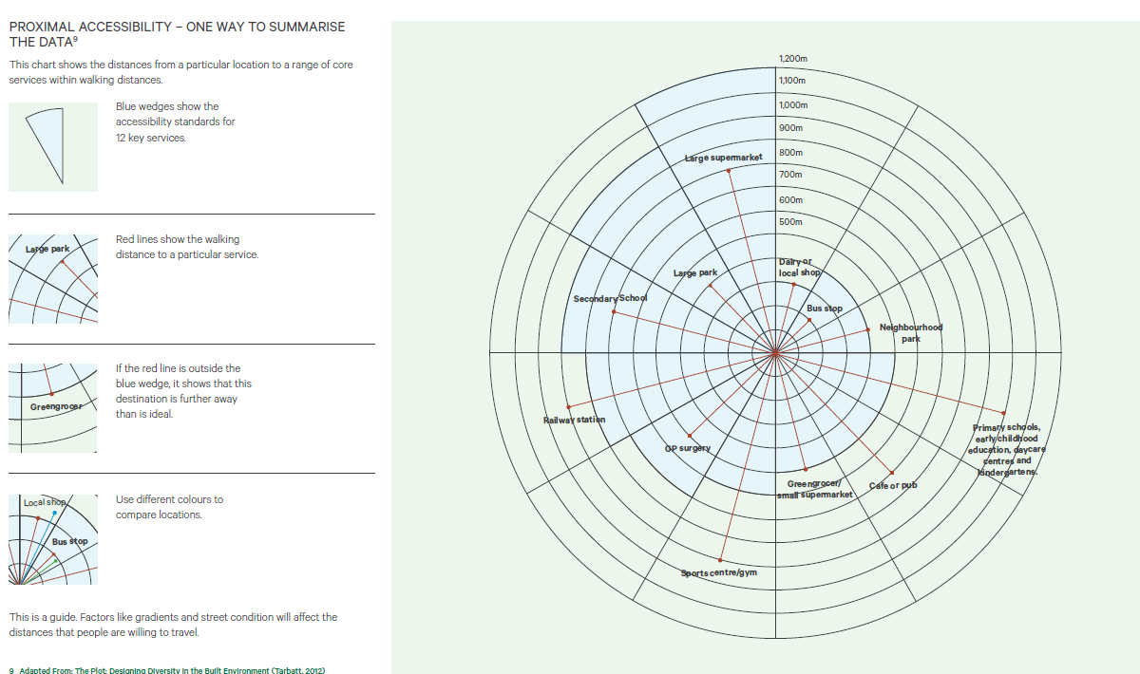
Walkable Catchments and Density
Masterplanning for Universal Design, Kāinga Ora
Towards an Urban Renaissance, Urban Task Force, UK, DETR 1999

Slide 18

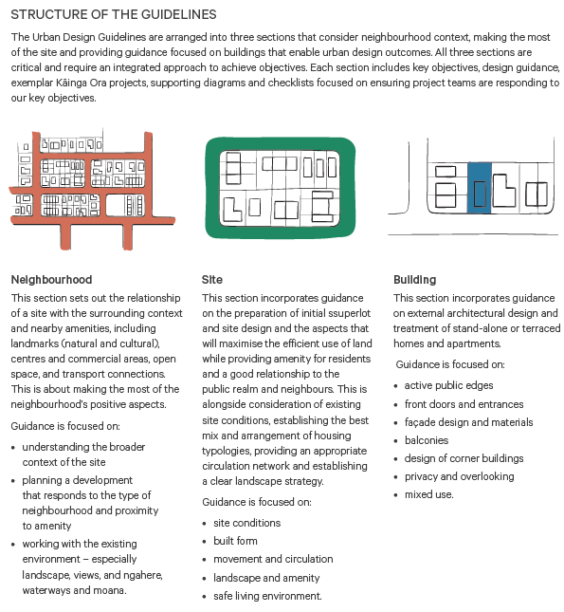
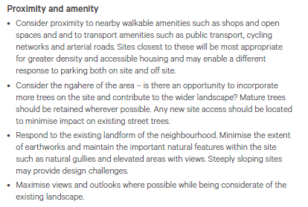
Walkable Catchments and Density

Slide 19
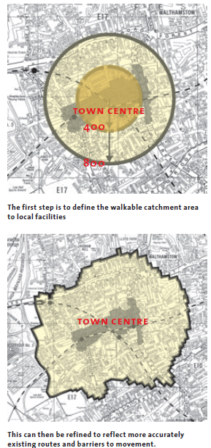
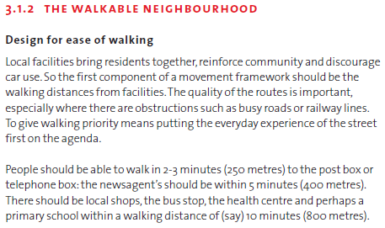
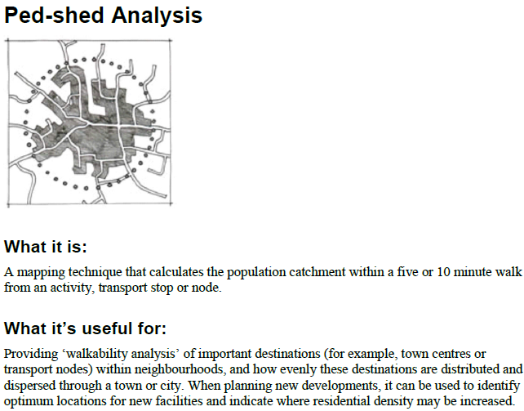


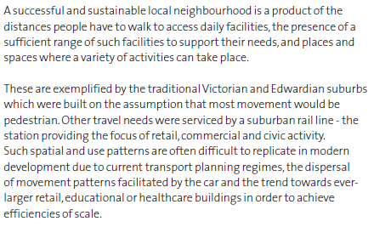
Walkable Catchments and Density
Urban Design Compendium, DETR, UK, 2000

